Slide 1

DATA SCIENCE
GRADUATE ORIENTATION
FALL 2020 Master & PhD Degrees
Prof. Mohamed Eltabakh

Slide 2
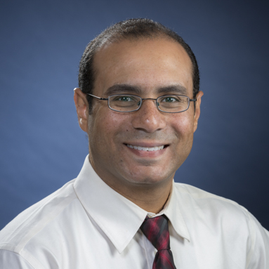

E. Rundensteiner, Ph.D. Prof. Computer Science Program Director Data Science
M. Eltabakh, Ph.D. Prof. Computer Science DS Grad Coordinator

Slide 3


Slide 4
What to Cover Today
MS & PhD Programs Overview
Degree Requirements and Structure
Course Registration
ADD/DROP Courses
Plan of Study
Petitions
Meeting Our Faculty
Q/A Session

Slide 5

MS Degree

Slide 6
MS – CORE + ELECTIVES
(33 Credits)
GQP 3 credits
OR
THESIS 9 credits
…Electives…
(15 credits)
(9 credits)
MATHEMATICAL
ANALYTICS
3 credits
DATA ACCESS
And
MANAGEMENT 3 credits
DATA
ANALYTICS &
MINING
3 credits
BUSINESS
INTELLIGENCE &
CASE STUDIES
3 credits
15 credits: CORE CLASSES
INTEGRATIVE DATA SCIENCE 3 credits

Slide 7
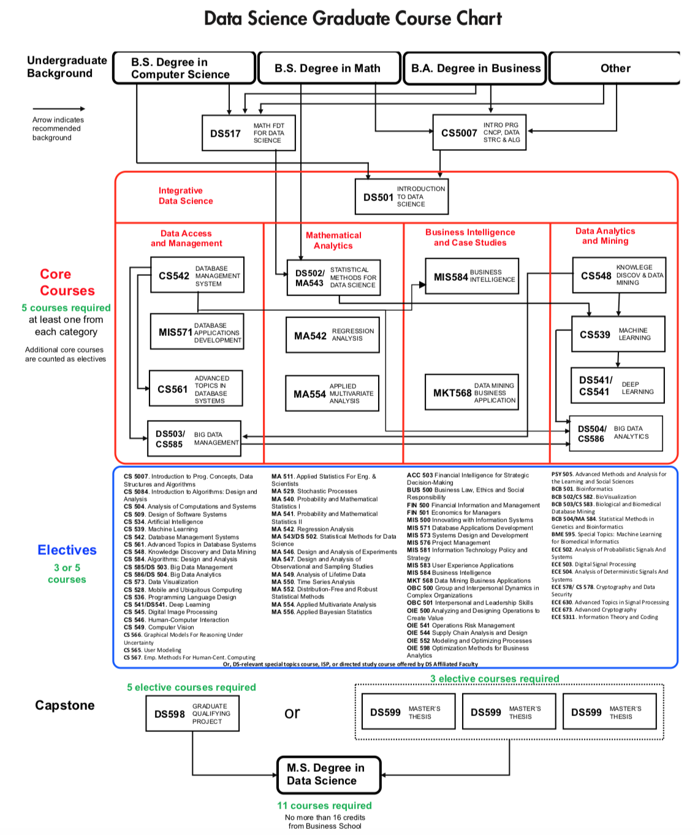
Not all of them are offered every semester

Slide 8
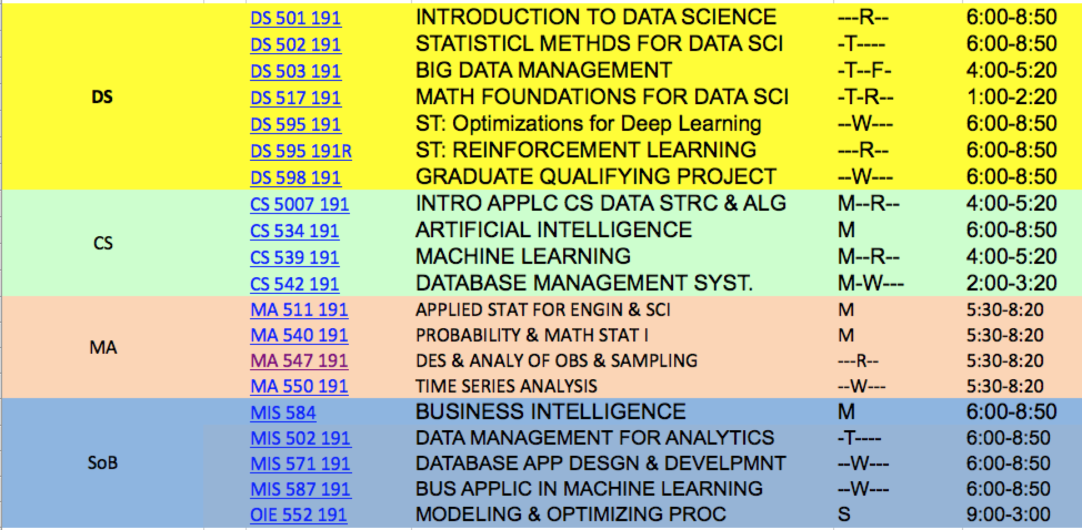
Fall 2020 Courses
Register in “On-Campus” courses (offered in TechFlex mode)
(offered either online (WEB) or hybrid (LEC.) mode)

Slide 9
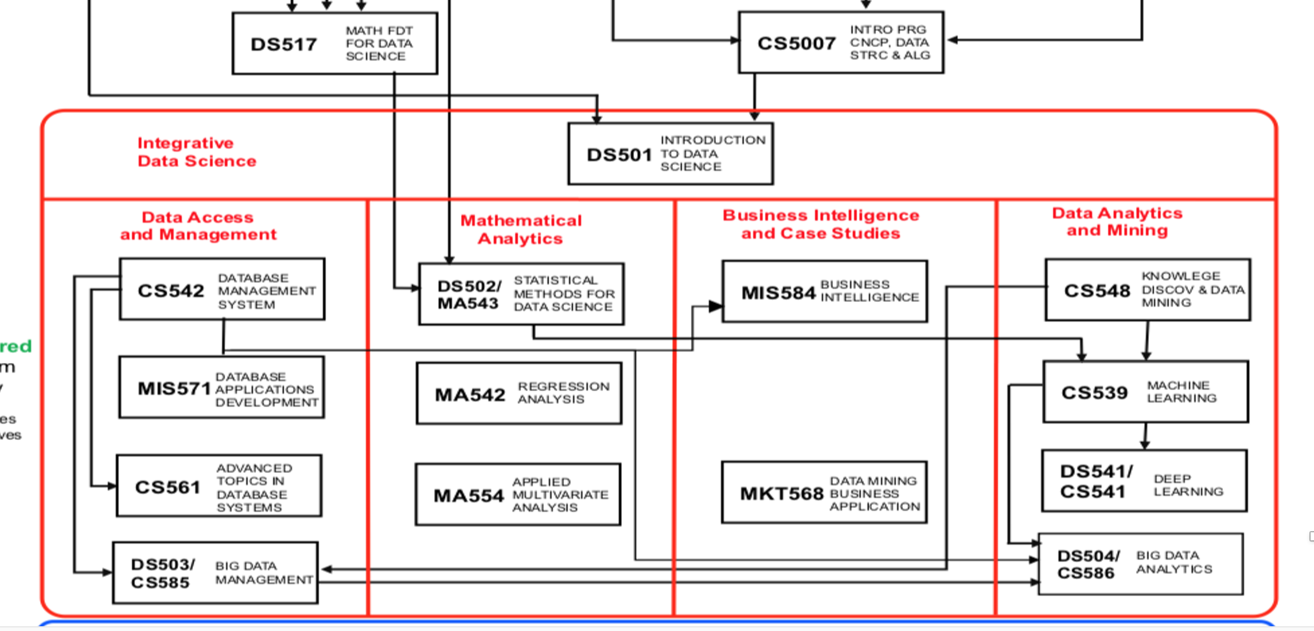
Fall 2020:ADVISE TAKEING CLASSES
Lacking CS/programming background
(Take CS5007)
Lacking statistics background
(Take DS517)
Everyone must take DS501
Hybrid (Lec) mode, Prof. Kong
Follow the arrows (pre-requisits) within each core area
{DS502, CS542}
{DS502, CS548}
{CS542, CS548}

Slide 10
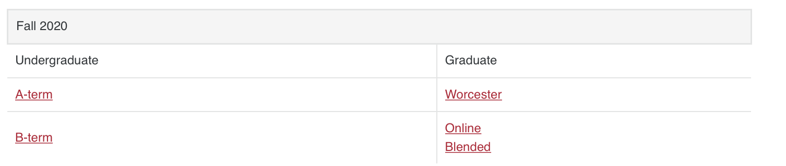
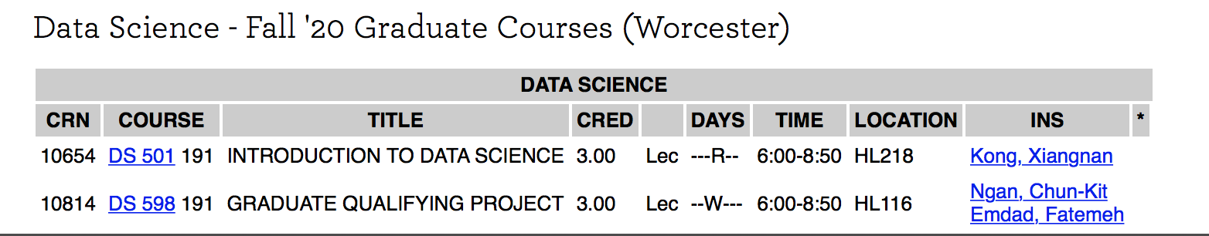
How to find the Hybrid (Lec.-Mode) Courses?
Register in “On-Campus” courses (offered in TechFlex mode)
(offered either online (WEB) or hybrid (LEC.) mode)
https://www.wpi.edu/offices/registrar/course-registration/schedules
Then select ‘Data Science’

Slide 11
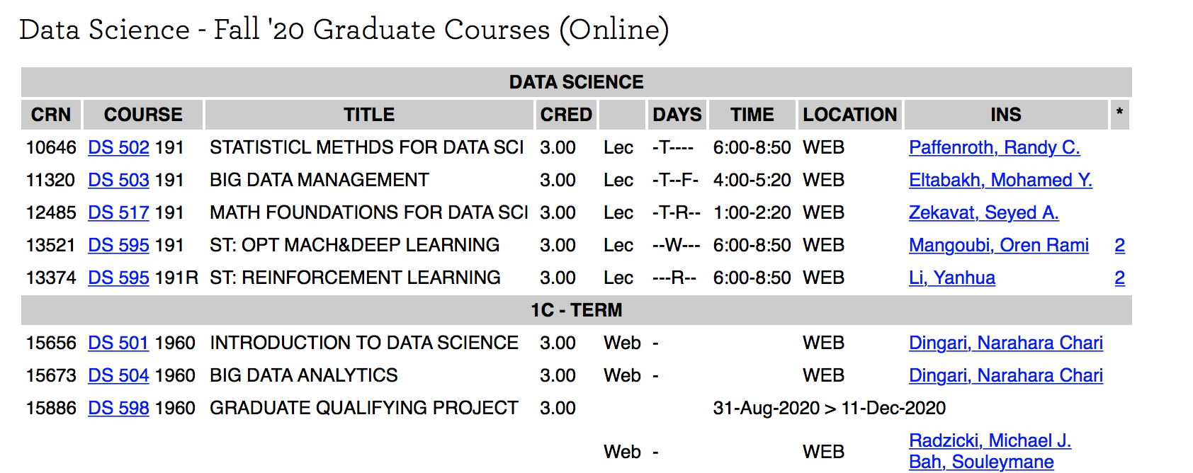
How to find the Online (Web-Mode) Courses?
https://www.wpi.edu/offices/registrar/course-registration/schedules
Then select ‘Data Science’
Select from this list
Online-degree courses
(Do NOT select from this list)

Slide 12
ADD/DROP DATES
Semester starts on Monday August 31st
ADD/DROP window without late fee
Monday, August 31, 2020 to
Friday, September 11, 2020, 8:00 am to 5:00 pm
Submission of forms is online and routed automatically for approval

Slide 13
WAIT LIST

Slide 14

NORMAL Load
FULL LOAD: 9 credits per semester
Course 1
Course 2
ISP
CS 598
Course 3
MS THESIS
If not on F1 visa in USA,
no need to be full time

Slide 15
BEYOND CLASSES
INDEPENDENT STUDY – DS596 (1-3 credits)
DIRECTED RESEARCH - DS597 (1-3 credits)
DS INTERNSHIP – DS5900 (0-3 credits)
GRADUATE QUALIFYING PROJECT (GQP) (3 credits)
MS THESIS (9 credits)
Interact closely (1:1) with faculty
Get exposed to research projects
Hands-on project experience

Slide 16









GRADUATE QUALIFYING PROJECT (GQP)
Taken in the
last semester
Strong
Industry
Partnerships
CAPSTONE EXPERIENCE
TEAM BASED
PRACTICE ORIENTED
CORPORATE SPONSORS
REAL-WORLD PROBLEMS
RESEARCH AND DEVELOPMENT

Slide 17
INTERNSHIP CPT:DS5900
CPT - INTERNSHIP FOR INTERNATIONAL STUDENTS
- REGISTER FOR CPT
- 3 CREDIT MAX TOWARD DEGREE
- REQUIRES ADVISOR’S SIGNATURE
It is highly recommended to do internship (But DO NOT OVERUSE)
Eligibility: After two full-time semesters in USA
REVIEW THE PROGRAM GUIDELINES FOR CPT

Slide 18
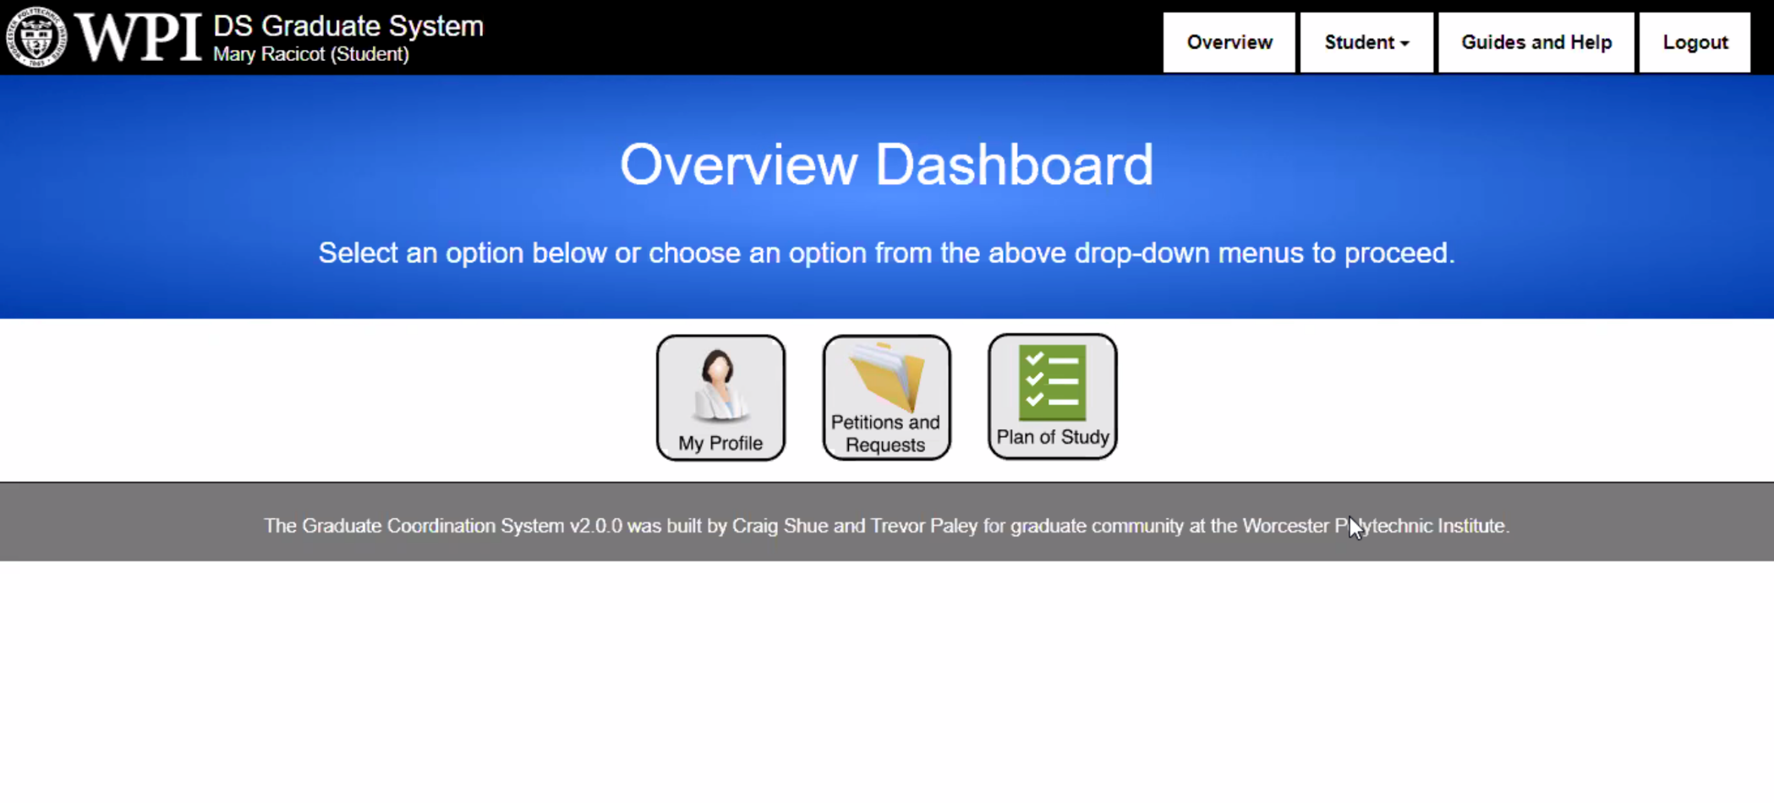
Plan of Study
Submit online using the “Graduate System” software
Submit each semester
Automatically routed to your advisor for approval
Follow the step-by-step manual for guidelines

Slide 19
PhD Degree

Slide 20
Ph.D. 90 vs Ph.D. 60
PH.D. 60 HOLDS RELEVANT MASTER‘S
EARNS 60+ CREDITS AT WPI
PH.D. 90 NO PRIOR MASTER’S DEGREE COMPLETE DS MS (33 CREDITS)
+ PH.D. 60 ** (57 CREDITS)

Slide 21


PhD CORE COURSE REQUIREMENTS
DEPTH
BREADTH

Slide 22
PhD 60 CORE PhD COMPETENCY
(30 credits - Graduate Course Work)
Core breadth competency [15 credits]:
3 credits in each of five areas
Core depth competency [6 credits]:
3 credit extra in two distinct areas
Must achieve 4 A and 3 B grades in 7 core courses

Slide 23
Ph.D. 60 RESEARCH REQUIREMENTS
Find and search for research advisor
Ph.D. Qualifying Examination (~1.0 year)
Directed study; 1 primary and 2 assigned co-advisors
Ph.D. Committee Formation
4 members: at least from 2 core DS depts; 1 outside WPI.
Ph.D. Dissertation Proposal (~2.5 years)
Proposal manuscript & presentation
Ph.D. Dissertation Defense (~ 4.0 years)
Dissertation manuscript & presentation

Slide 24
Plan of Study & Petitions
Submit online using the same “Graduate System” software
Follow the step-by-step manual for guidelines

Slide 25
PETITION: Waive Core Area Requirement?
You took equivalent courses somewhere else
Petition to have these prior courses to “count” as fulfilling a corresponding core area
No credit reduction

Slide 26
PETITION: Transfer of Credit?
You relevant and qualifying courses somewhere else
&
These courses are not used in another degree
Transfer “credits” into WPI to reduce the # of credits towards degree (pay less)
They can also fulfil core area requirements (if applicable)

Slide 27
Meeting Our Faculty

Slide 28


